Slide 1
In the Mix Background
Year
University Name

Slide 2

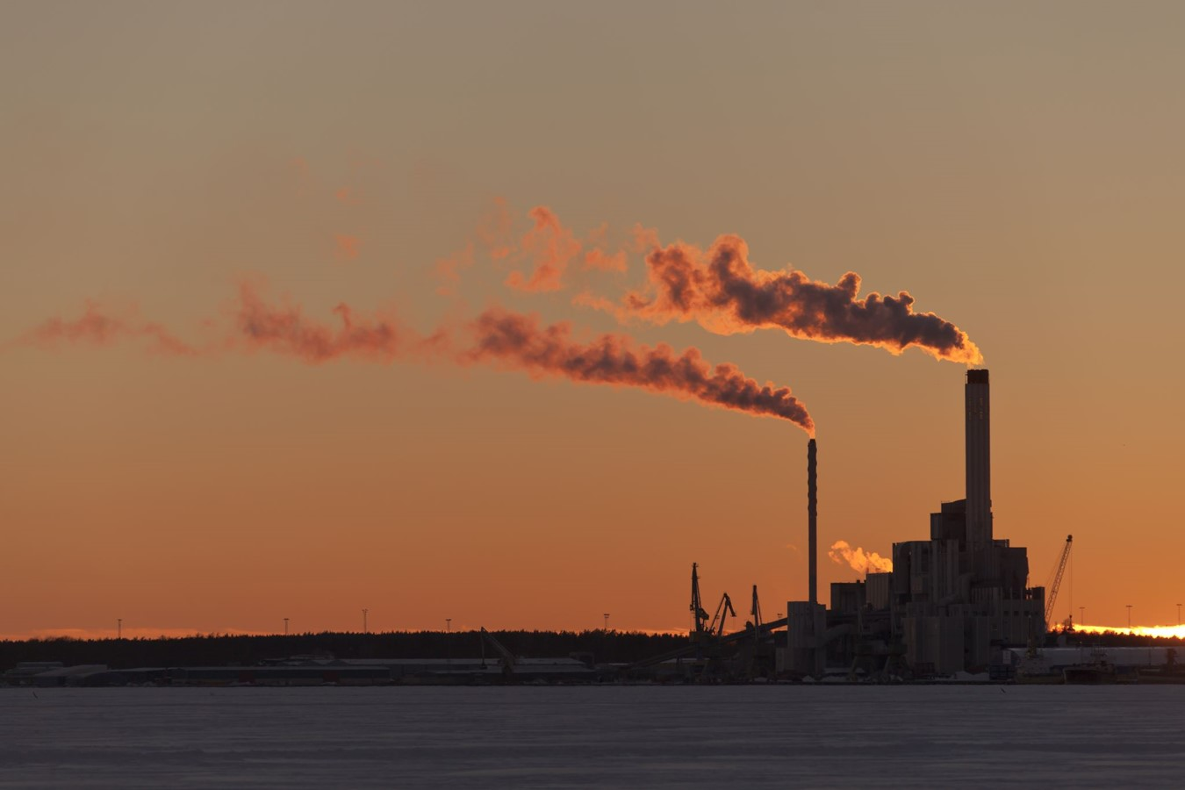
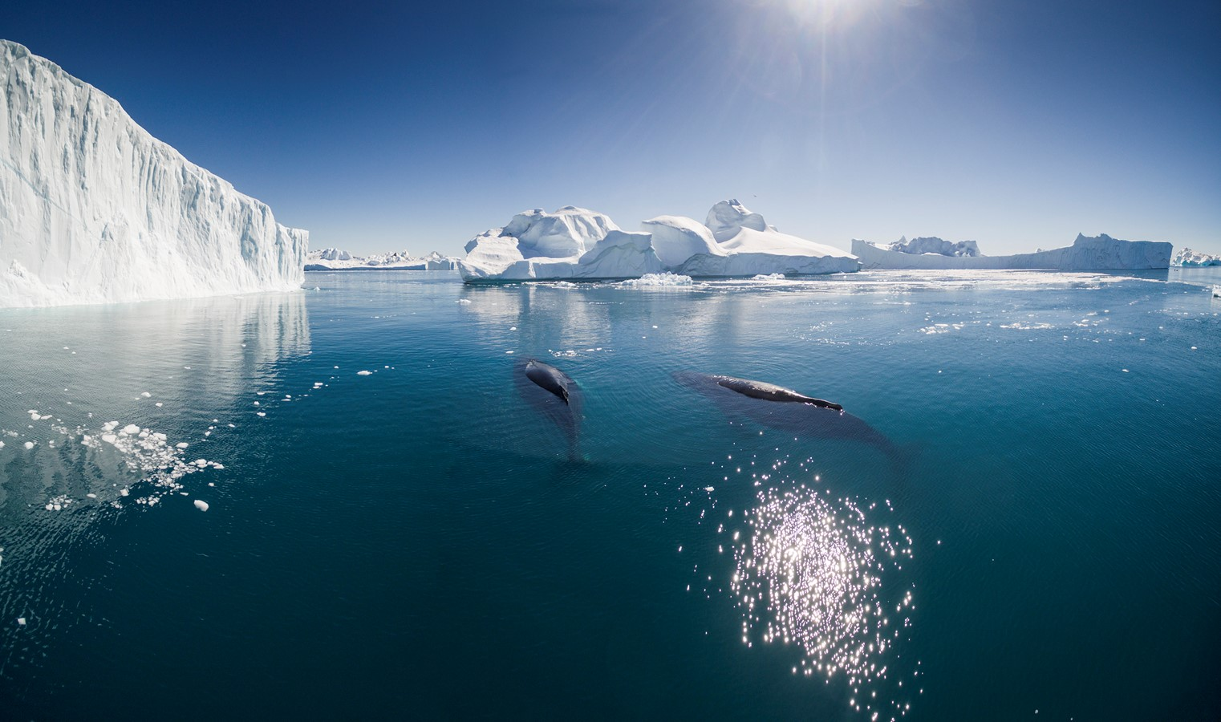
Climate Change

Slide 3




The Need for Energy Storage

Slide 4
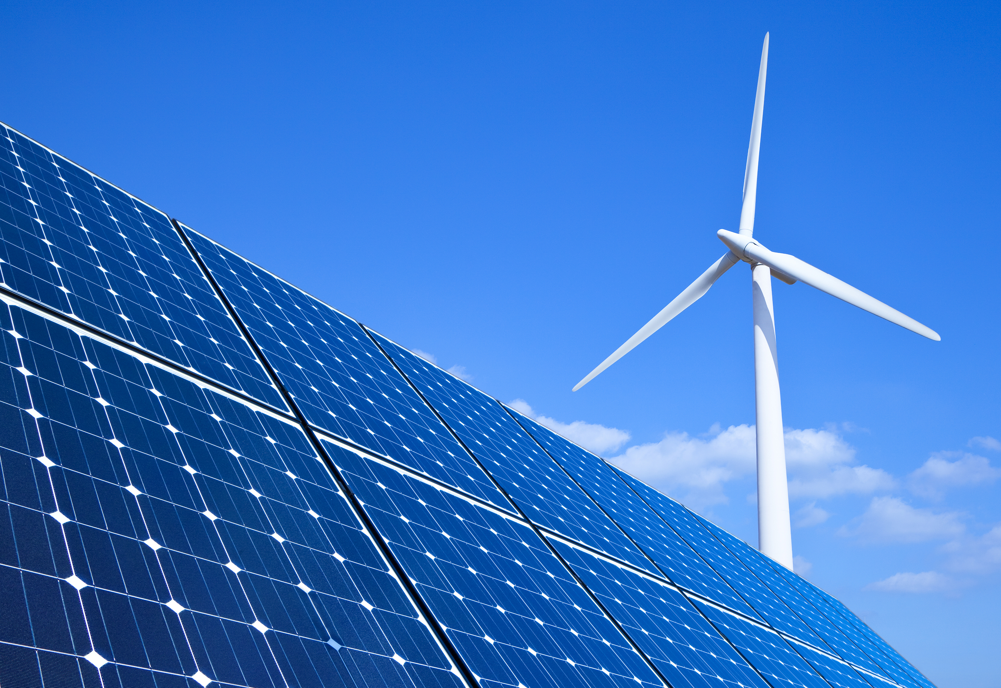
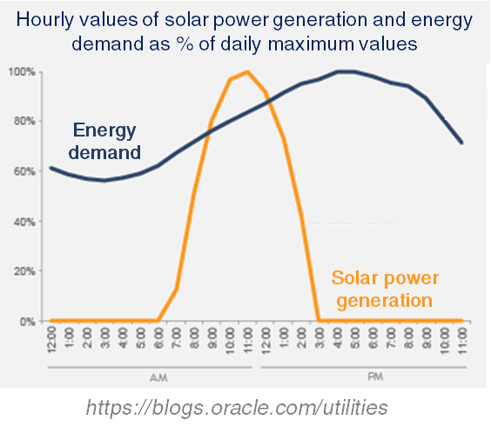
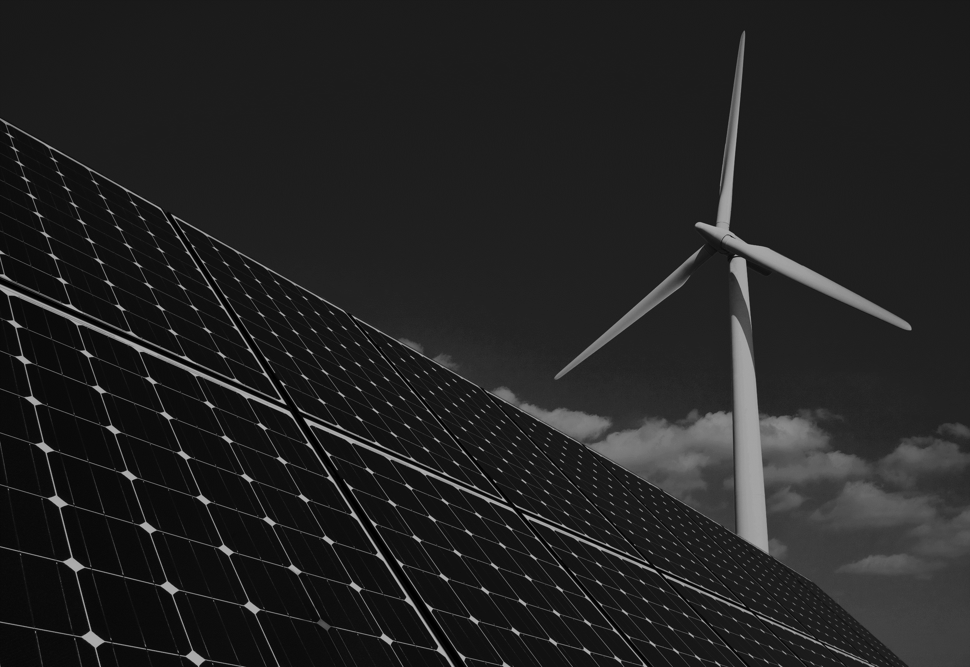

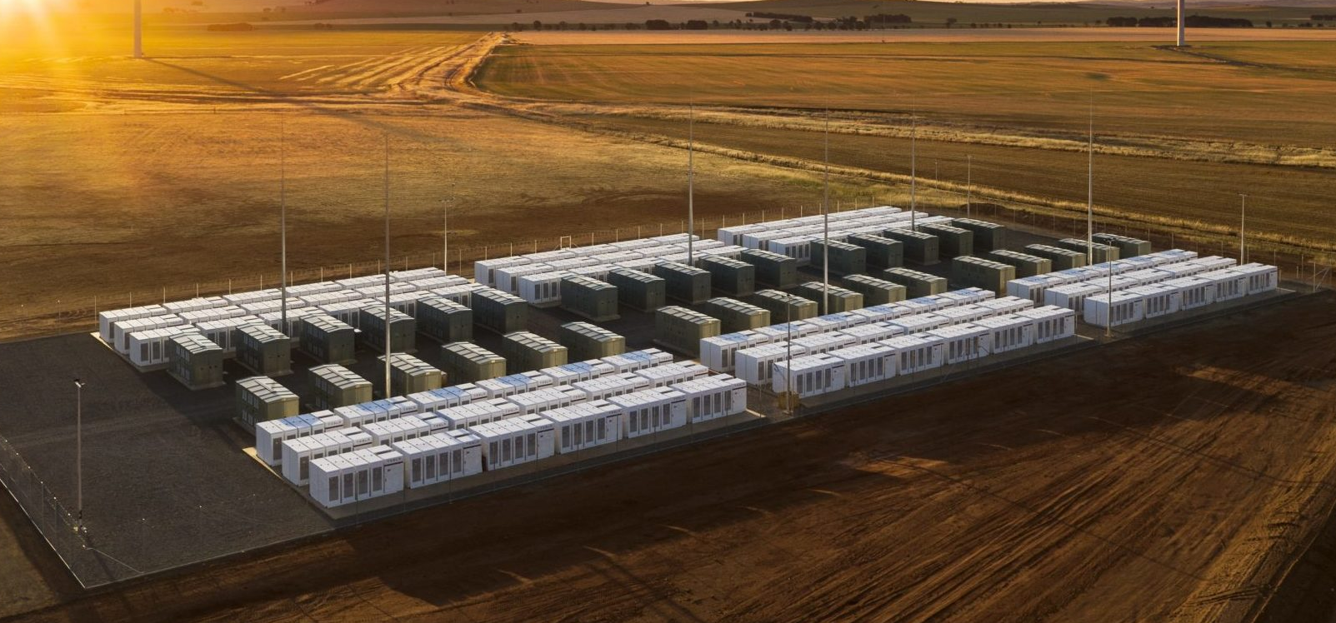

Need for Energy Storage
Renewable Energy
Intermittent nature of renewable energy resources
Especially at Large Scale…
Hazardous
High maintenance costs
Relatively low lifespan
Lithium-Ion Batteries

Slide 5
What is a Redox Flow Battery?

Slide 6

Scalable Energy Storage
Redox Flow Battery (RFB)
Decouples energy capacity and power
Store large quantities of energy cheaply and safely
Organic: more abundant, less corrosive, and less toxic (compared with vanadium, bromine, chromium)
Catholyte
Analyte
+
-
pump
pump

Slide 7


Power sources (solar/wind)
Notes:
General overview of RFB- add animations for things appearing gradually to explain as we go

Slide 8

Power sources (solar/wind)
Grid energy
Power supply
Notes:
General overview of RFB- add animations for things appearing gradually to explain as we go

Slide 9


Power sources (solar/wind)
Grid energy
Power supply
e‒
Load
e‒
E_{cell} = E_{cath} - E_{anode}
∆G = -nFE
Charge
(+∆G and -E)
Anode
Cathode
Ion-exchange membrane
Notes:
General overview of RFB- add animations for things appearing gradually to explain as we go

Slide 10

Power sources (solar/wind)
Grid energy
Power supply
e‒
Load
e‒
E_{cell} = E_{cath} - E_{anode}
∆G = -nFE
Discharge
(-∆G and +E)
Anode
Cathode
Ion-exchange membrane
Notes:
General overview of RFB- add animations for things appearing gradually to explain as we go

Slide 11
Power sources (solar/wind)
Grid energy
Power supply
∆G = -nFE
E_{cell} = E_{cath} - E_{anode}
Anolyte tank
Catholyte tank
Notes:
General overview of RFB- add animations for things appearing gradually to explain as we go

Slide 12
Power sources (solar/wind)
Grid energy
Power supply
∆G = -nFE
E_{cell} = E_{cath} - E_{anode}
Anolyte tank
Catholyte tank
Electrode
Electrode
Notes:
General overview of RFB- add animations for things appearing gradually to explain as we go

Slide 13
Power sources (solar/wind)
Grid energy
Power supply
∆G = -nFE
E_{cell} = E_{cath} - E_{anode}
Anolyte tank
Catholyte tank
Electrode
Electrode
Ion-exchange membrane
Notes:
General overview of RFB- add animations for things appearing gradually to explain as we go

Slide 14
Power sources (solar/wind)
Grid energy
Power supply
∆G = -nFE
E_{cell} = E_{cath} - E_{anode}
Anolyte tank
Catholyte tank
Electrode
Electrode
Ion-exchange membrane
Pump
Pump
Notes:
General overview of RFB- add animations for things appearing gradually to explain as we go

Slide 15


Power sources (solar/wind)
Grid energy
Power supply
e‒
e‒
∆G = -nFE
E_{cell} = E_{cath} - E_{anode}
(+∆G and –E)
Charge
Charge
Anolyte tank
Catholyte tank
e‒
e‒
Electrode
Electrode
Ion-exchange membrane
Pump
Pump
Notes:
General overview of RFB- add animations for things appearing gradually to explain as we go

Slide 16

Power sources (solar/wind)
Grid energy
Power supply
e‒
e‒
∆G = -nFE
E_{cell} = E_{cath} - E_{anode}
(-∆G and +E)
Discharge
Discharge
Anolyte tank
Catholyte tank
e‒
e‒
Electrode
Electrode
Ion-exchange membrane
Pump
Pump
Notes:
General overview of RFB- add animations for things appearing gradually to explain as we go

Slide 17
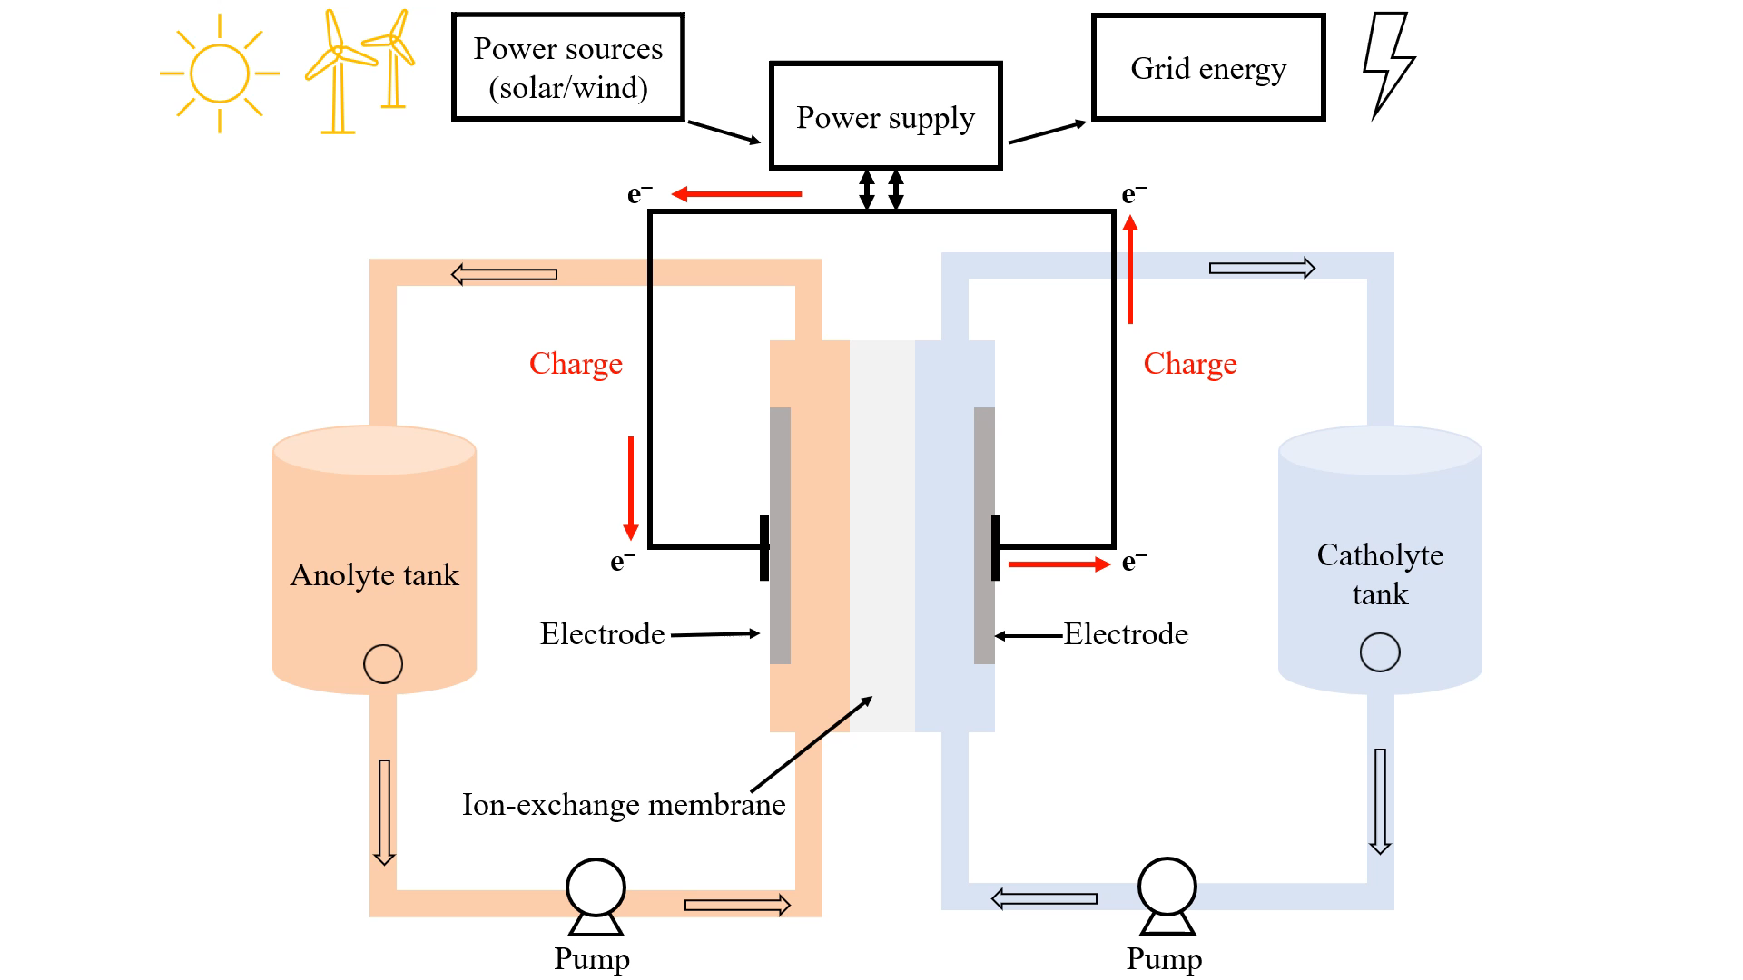
∆G = -nFE
E_{cell} = E_{cath} - E_{anode}
(+∆G and –E)

Slide 18



How do we develop Redox Flow Batteries?

Slide 19


Finding the Best Materials
Redox Potential
Transport
Solubility
Stability
High Capacity
High Voltage
Long Performance Lifetime
High Efficiency
Transport
Stability
Catholyte
(or Anolyte)
Material
Redox Potential
Solubility

Slide 20

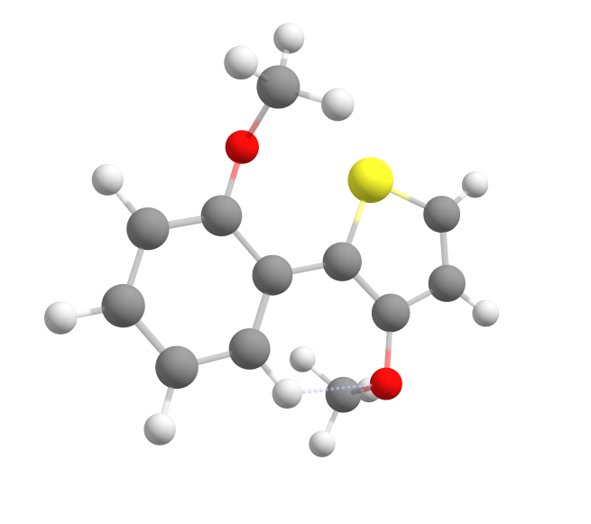
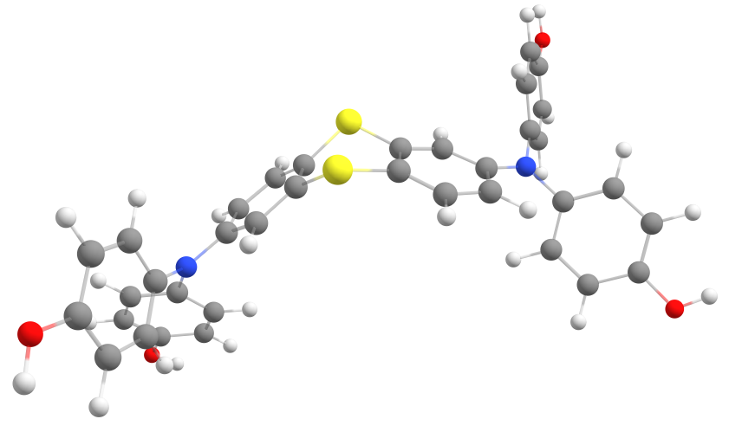
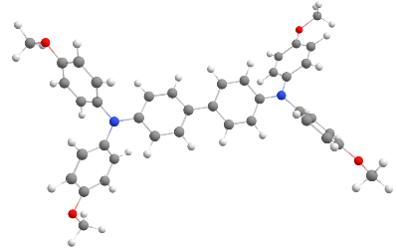





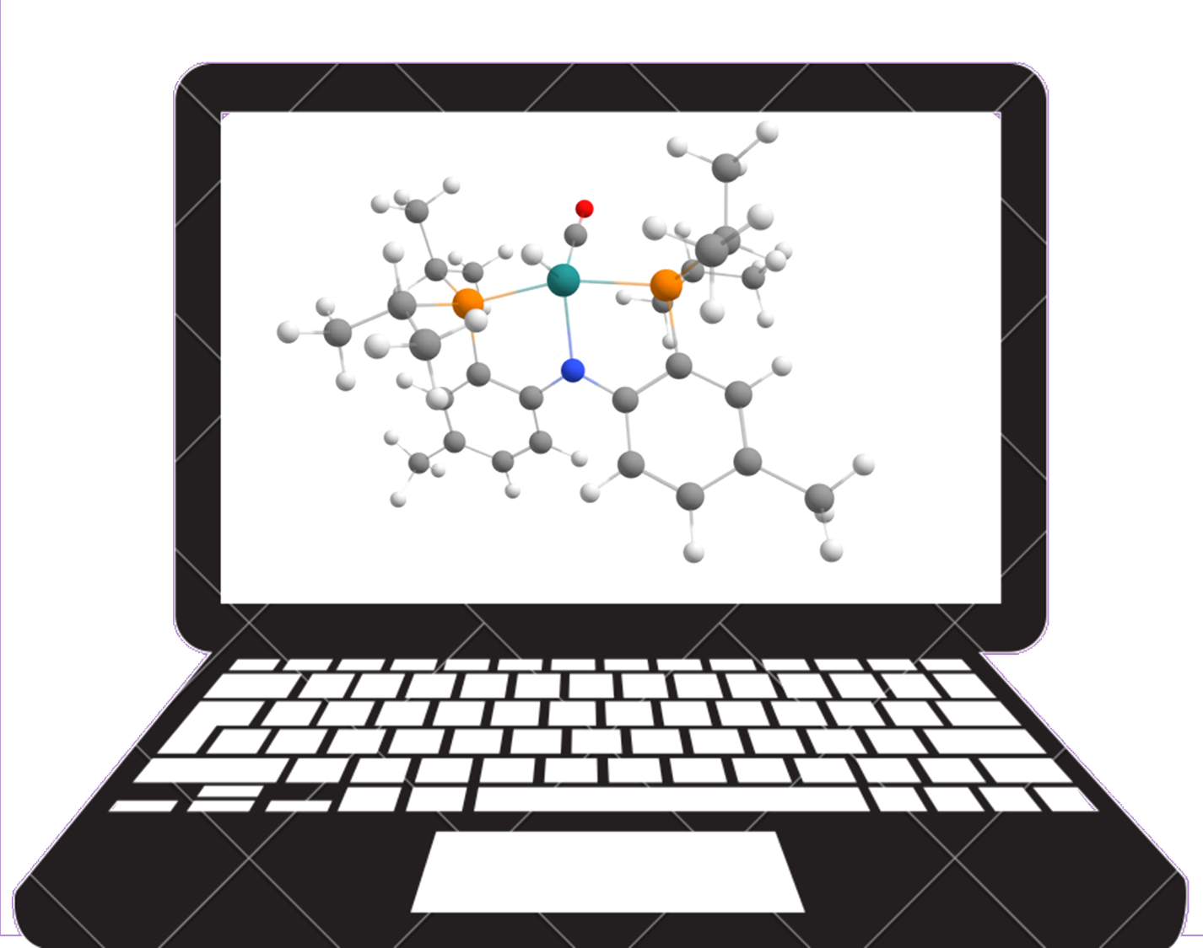









D³TaLES Vision
Machine Learning Screening
Experimentation
Computation
Quantum Calculated Properties
Database
Expert-Informed Selection
Literature
Experimental Validation
Robotic Experiments
RFB Materials
Community
Machine Learning
d3tales.as.uky.edu

